Slide 1




FELIX MUKUNGU
Founder, The Core
Bitcoin Educator
Graphic Designer
MukunguFelix
Felix Divoar
felixdivoar

Slide 2
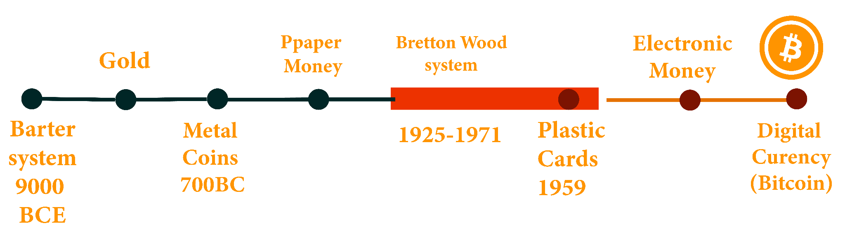
CHAPTER 2:
The concept of money has elevated overtime

Slide 3
In ancient civilization people relied on bartering, a system of direct exchange of goods & services without the use of a medium of exchange
Early forms of money
In barter economies, people trade with each other based on the relative value of goods and services that they have to offer.
Challenges
Double coincidence of wants problem
Complex
Example page 30 & 31

Slide 4
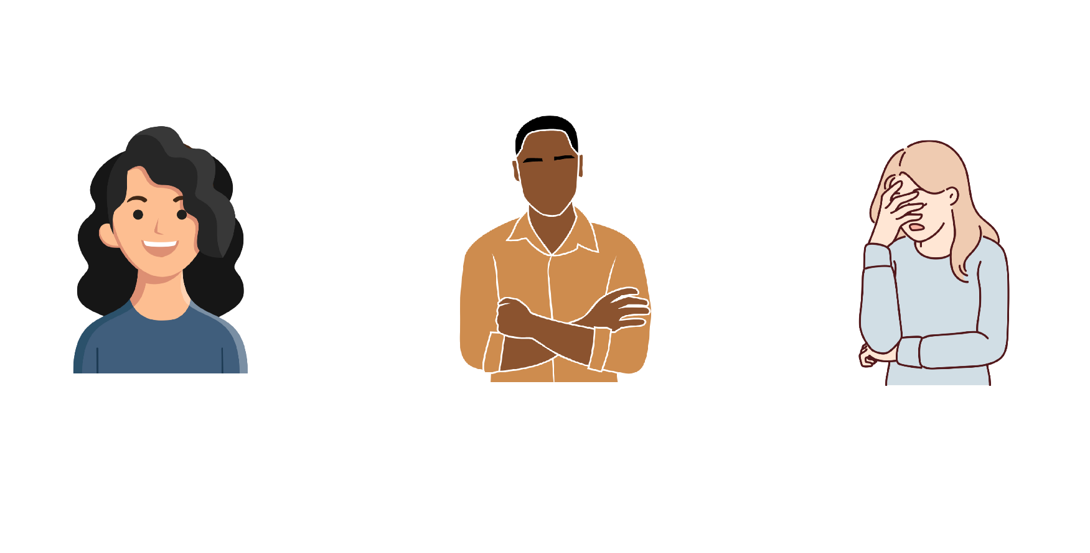

Slide 5
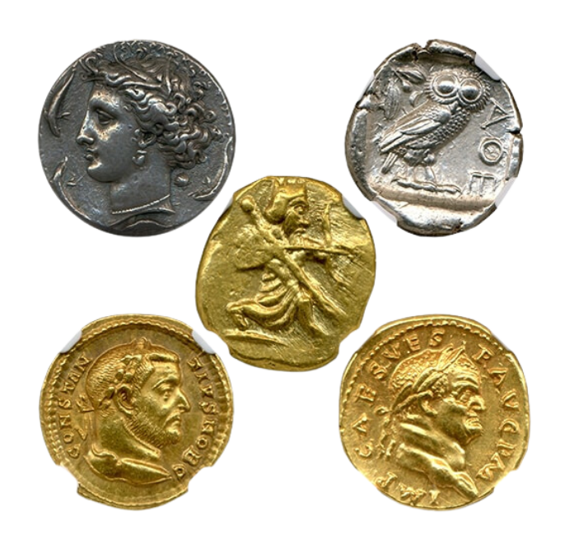
Metal Coins
Metal coins were made of materials like gold & silver, and served as a medium of exchange and unit of account to facilitate trade and
Commerce : Commodity Money

Slide 6
Challenges
Heavy and inconvenient to carry large transactions
Debasement - Melting coins and creating new ones by mixing them
With cheaper metals which causes prices to rise
and undermines trust in the system.
Paper Money
Paper money emerged as a form of money
Originated from ancient china
They were convenient and easily exchangeable and they were backed by gold.

Slide 7
Transition from sound to unsound money
Fast forward to the 17th century in sweden . Now you completely depend on banks to store your valuable asset. However you start to notice something fishy going on with this bankers, they start issuing more paper money receipts than they have in gold storage allowing them to create more money than they have gold in storage allowing them to create more money than they have assets to back it up.
Profit mechanism
The profit comes from the fact that the total value of issues papers exceeds the actual gold reserves

Slide 8
For example, the bank had 100 ounces of gold in reserve and issued 1000 ounces,they were effectively creating money on paper. This allowed them to lend more money than they physically possessed.
Interest on loans
The early bankers would make money by lending out the axcess receipt (money created on paper) to borrowers, charging them interest
Bretton Wood system
In 1944, the Bretton woods agreement is signed, establishing U.S dollar as the world's reserve currency and fixing the value of the U.S dollar to the price of gold at a rate of $35 per ounce. Other currency are pegged to the dollar which helps stabilize international financial markets.

Slide 9
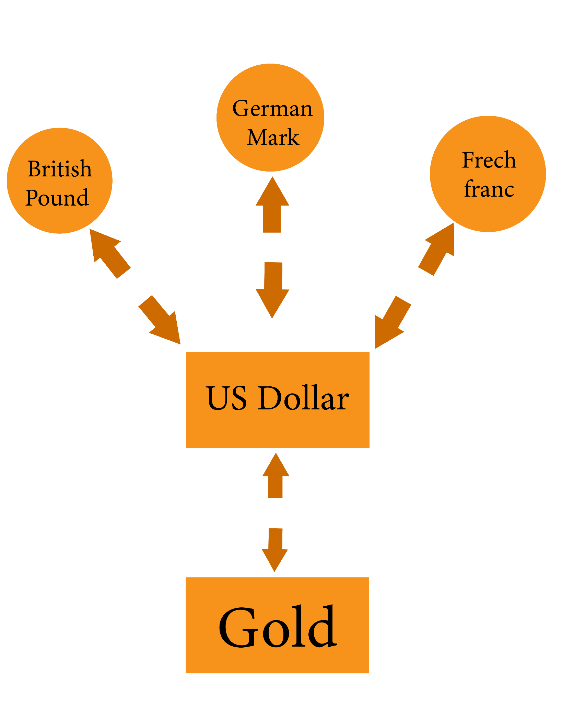
Bretton Woods System was a post - world war II system that was established during a conference held in Bretton Woods, New Hampshire USA in July 1944 - key features of the Bretton Woods System included fixed exchange rates, U.S dollar to be world's reserve currency and the creation of IMF & world bank.

Slide 10
In 1971 President Nixon suspended the convertibility of the dollar into gold
This marked the end of the gold standard and the beginning of the world
driven by creation and accumulation of debt
Effects
The US dollar starts to be affected by inflation (rising prices) prices, interest
rates, the strength of the country’s economy, political events, market speculation & demand in international trade.
Effects on People's living standard
Abuse of centralization
Rising prices
Weakening currencies
The need to spend more money for fewer things.

Slide 11
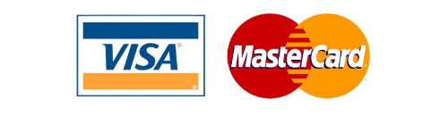
Credit Cards
The first credit card was introduced in 1950s. With a simple swipe of
plastic , we can buy whatever we want, whenever we want without
any hassle
Online payments
As technology advances, so does the way we handle money. The internet becomes a major player in the financial world with online banking and ecomerce websites, making it possible to manage and
Spend money entirely online.

Slide 12

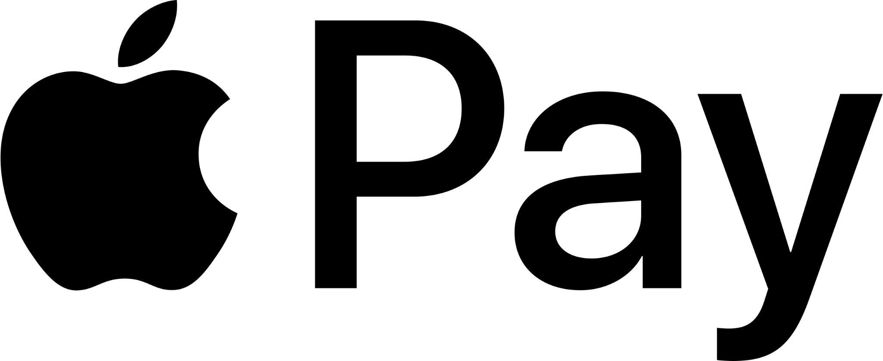
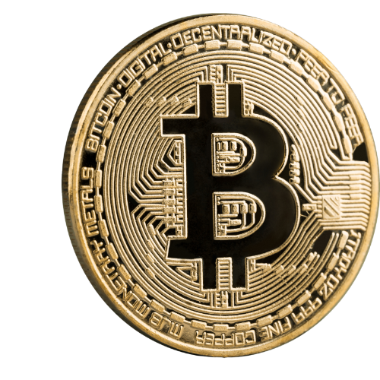
Digital Currency (Bitcoin)
Bitcoin was first introduced in 2009 by pseudonymous person/people known as Satoshi Nakamoto. As Bitcoin grows its popularity grows, it inspires the creation of new technologies & unknown frontiers for the future of money.

Slide 13
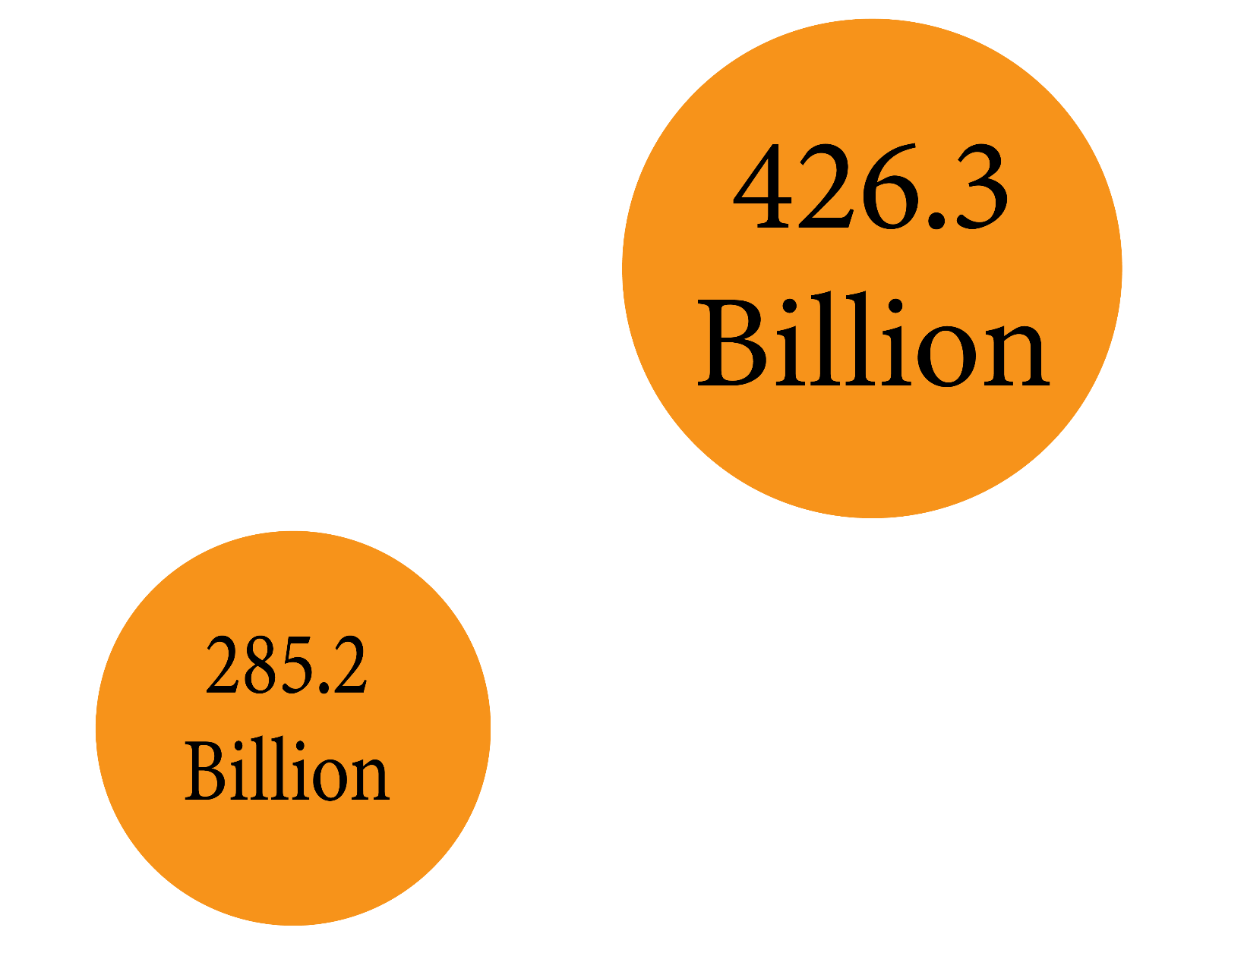
The Price Of Control
The Rice of cashless society
By 2015 there were 426 billion
Cashless transactions worldwide
A 50% increase from five years
before
2015
2010

Slide 14
War on cash is the term that refers to various efforts to reduce the use of physical money,remove high denomination bills and promote the use of electronic payment
Proponents - It will make transactions faster, more
Secure
Proponents - Loss of privacy & financial inclusion
Increased risks of fraud & cyber-attacks
Cash has always been king but starting in the late 90s the convenience
Of new technologies have helped make non-cash transaction to become
More viable. But cash is still used 85% of all the transactions worldwide

Slide 15
Shots fired
Removing high denomination of bills from circulation makes it harder for terrorist, drug dealers money launderers and tax evaders
Traceable Money gives regulators more control over the economy
Cashless transaction are faster & more efficient
Caught in the crossfire
Cashless transactions would always include some intermediary or
third party
Increased government access to personal transactions & records
Certain types of transactions (gambling. etc) could be barred
or frozen by the government

Slide 16
Caught in the crossfire
Decentralized digital currency (bitcoin) could be alternative for such transactions.
Savings
Savers could no longer have individual freedom to store wealth ‘outside’
The system
Eliminating cash makes negative interest rates (NRP) a feasible option for Policy makers
A cashless society also means all savers would be ‘on the hook’ for bank bail-in scenarios
Savers will have a limited abilities to react to extreme monetary events like deflation or inflation

Slide 17
Cyber security
With wealth stored digitally, potential risk impact of cybercrime increases
Surveillance
Surveillance is a tricky business. On one hand, it helps people doing bad
things like money laundering. But the more fraud that happens the more
Surveillance is needed which too can lead to invasions of privacy through’
technology

Slide 18
Future effect
The Rich
The Poor
Access to
Personal information
May have access to extensive
Personal information and can
Use it to make informed decisions
May lack this information and may have to rely on outdated or unreliable sources
Ability to shape the world
In their own interest
May use their access to data to
Shape the world in their own
interest
May have a little influence on what happens
Vulnerability to
Digital scams, online
Harassment, extortion
and identity theft
Likely less vulnerable to these
Issues with more information and
more
Protection from such scams
May be more vulnerable to these
issues due to lack of access to
resources and information

Slide 19
Financial Regulations & censorship
Capital controls sanctions when spending gets out of control, government may impose price controls to try and fix the problem
but sometimes this controls make things worse.
Restrictive banking
Have you ever tried to withdraw cash from ATM only to find out
You’ve reached your daily limit ?.
Expensive remittance
Sending money to other countries can be expensive due to fees
From banks and other financial institutions

Slide 20
The unbaked and the underbanked
Not everyone has access to traditional banking, weather it is
Because they don’t meet the requirements to open and account
Or they live in areas where banking services.

